Slide 1
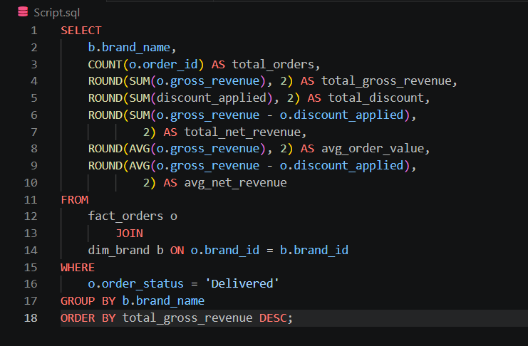
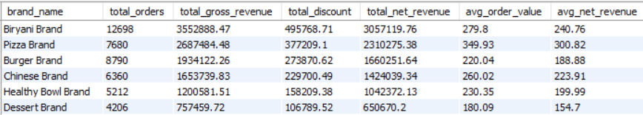
Brand Metrics Summary
This query analyzes the performance of each brand by calculating total orders, gross revenue, discounts, net revenue, and average order values using only delivered orders.

Slide 2
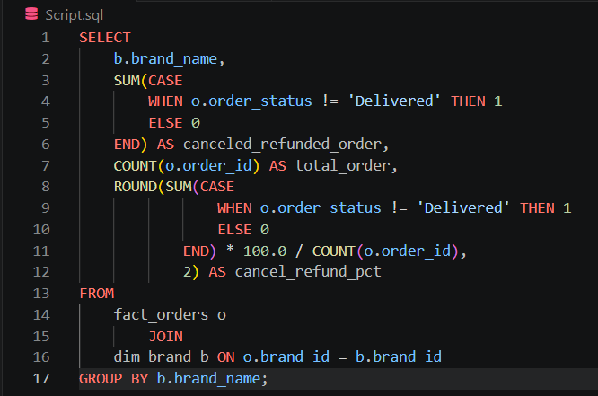
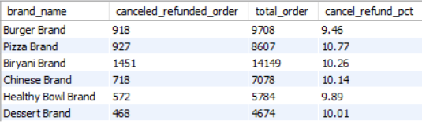
Which brand has the highest number of cancelled or returned orders?
If a brand has massive total orders but a high cancel or refund pct, it means marketing is doing a great job bringing people in, but the kitchen operations or delivery fleet is failing them.

Slide 3
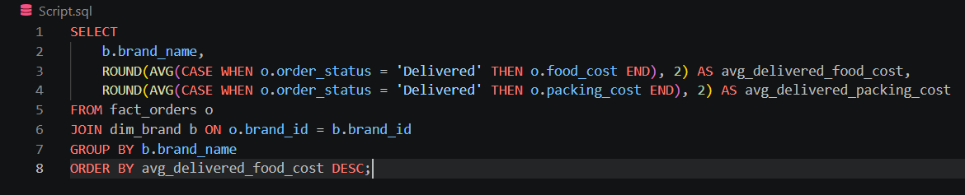
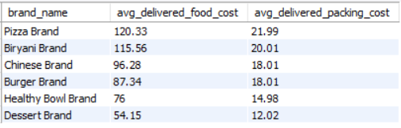
What is the average packing cost vs. average food cost for each brand?
This query highlights if a brand is overspending on premium packaging for low-ticket menu items.

Slide 4
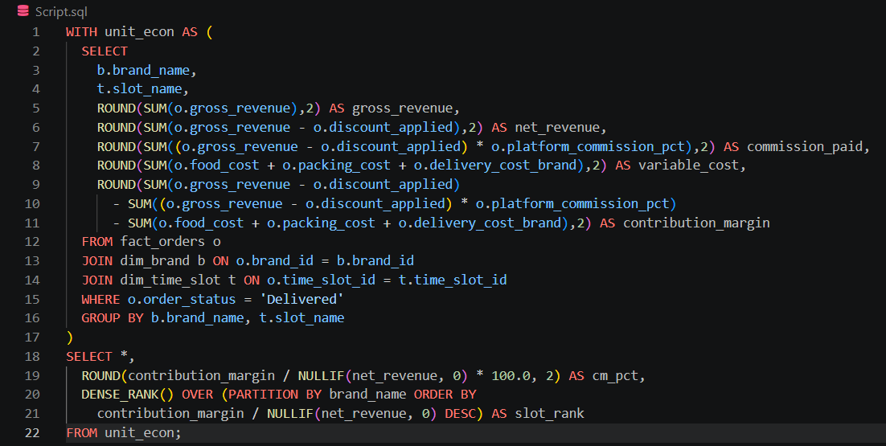
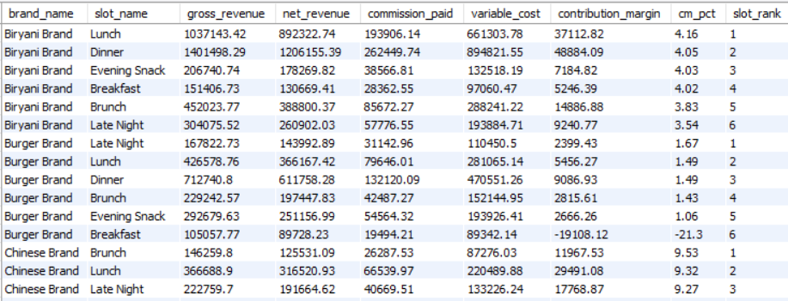
Unit Economics per Brand per Time Slot
This query evaluates the unit economics of each brand across different time slots by calculating gross revenue, net revenue, commission paid, variable costs, contribution margin, and contribution margin percentage for delivered orders.
It also ranks the time slots within each brand based on contribution margin percentage, helping identify the most profitable time periods for every brand.

Slide 5
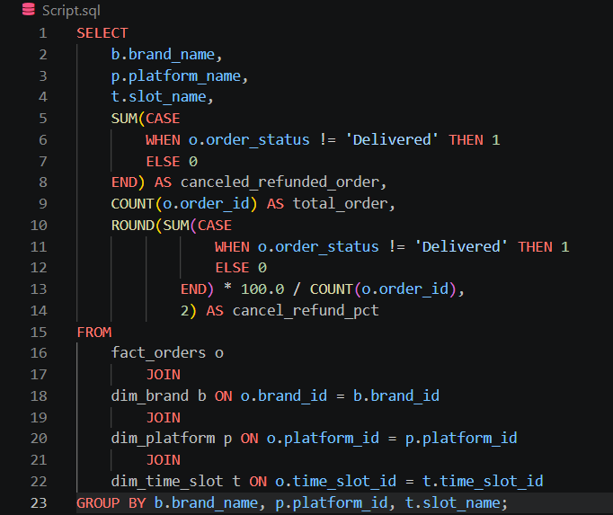
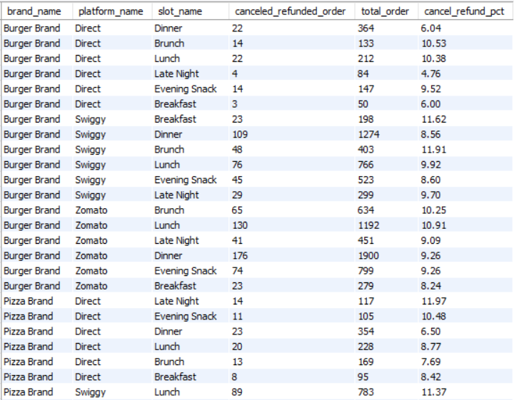
Multi-dimensional Grain Analysis (Brand + Platform + Time Slot)
This query analyzes order performance at the combined level of brand, platform, and time slot by calculating total orders, cancelled / refunded orders, and the cancellation/refund percentage.
It helps identify which brand-platform-time slot combinations experience the highest cancellation rates, enabling better operational and customer service decisions.

Slide 6
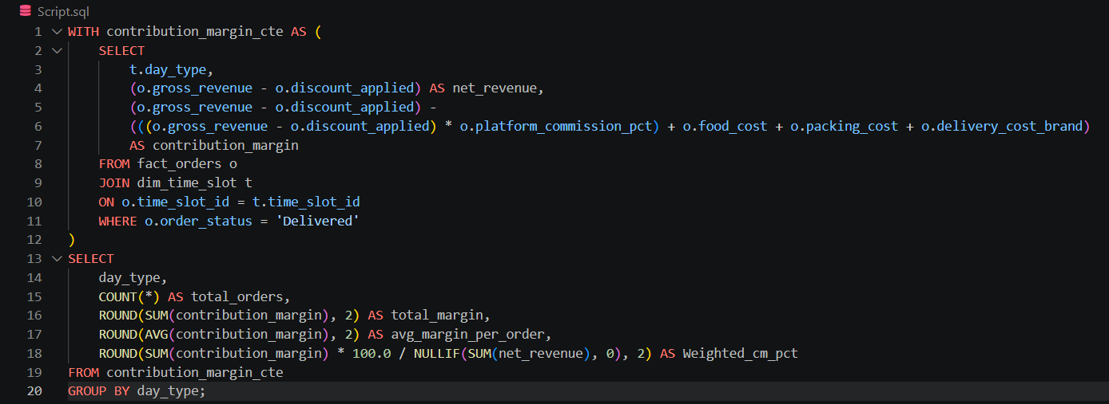

How does the Contribution Margin % (CM%) behave on Weekends vs. Weekdays?
Operational Recommendation:
The company should allocate 60% of performance marketing budget exclusively to Friday-Sunday campaigns, as physical kitchen spaces yield disproportionately higher cash velocity during weekend spikes.

Slide 7
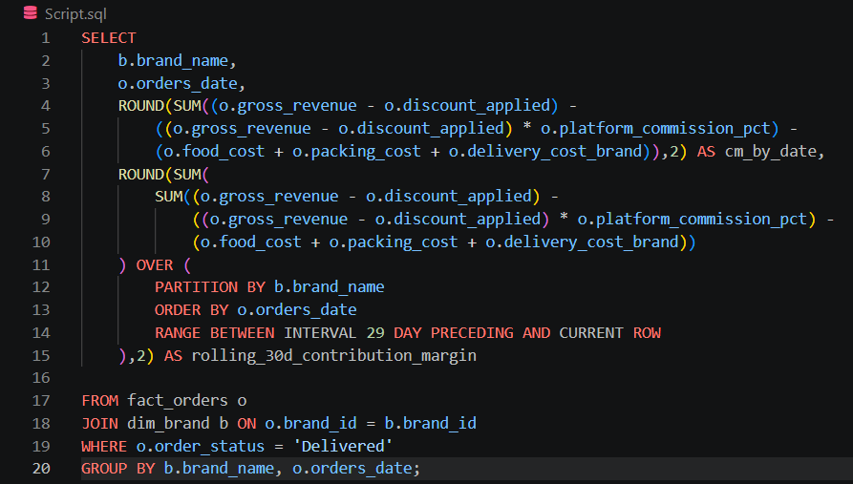
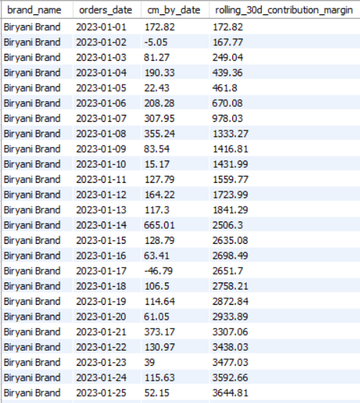
Rolling 30-Day Contribution Margin Trend per Brand
It helps smooth out daily fluctuations, making it easier to identify long-term performance patterns and monitor whether a brand's profitability is improving or declining.

Slide 8
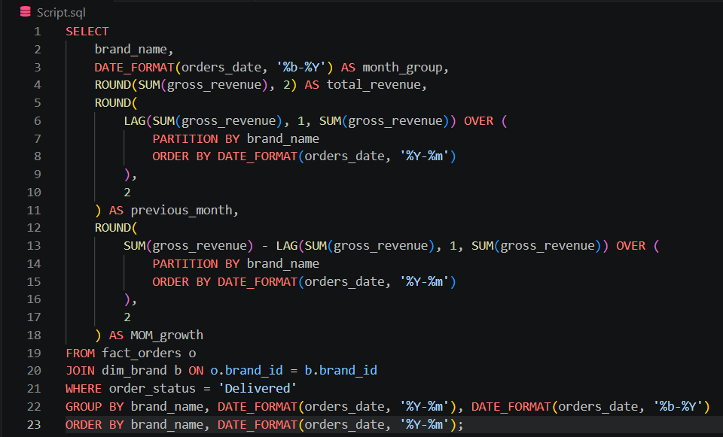
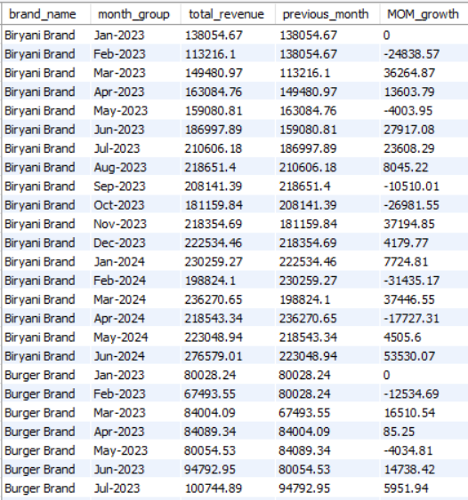
Month-on-Month (MoM) Growth
It helps track revenue trends over time, making it easy to identify periods of business growth, decline, or stable performance for each brand.

Slide 9
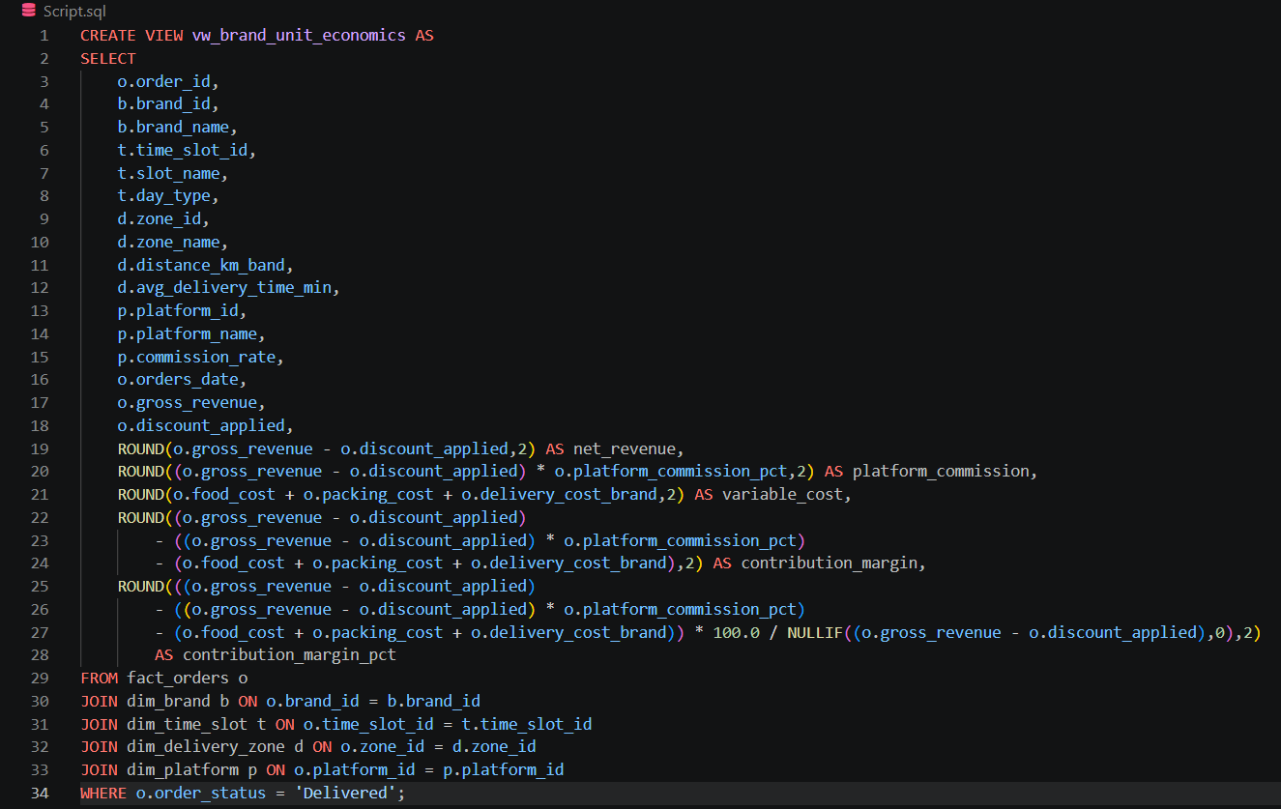
Brand Unit Economics View
It provides a reusable analytical layer that simplifies reporting and enables faster analysis of profitability across brands, platforms, time slots, and delivery zones without rewriting complex calculations.

